Slide 1
Malignant Comments Classifier
By – Vaishali Chavan

Slide 2
Problem Statement And Understanding
The problem we sought to solve was the tagging of internet comments that are aggressive towards other users.
Our goal is to build a prototype of online hate and abuse comment classifier which can be used to classify hate and offensive comments so that it can be controlled and restricted from spreading hatred and cyberbullying.

Slide 3
Approach
The internet comments that are toxic/ clean are used for training and testing the models.
The Dataset contains multiple labels to mark the toxicity of the comments. We are dealing with a multi-label classification problem.
The comments are used as the input. These comments are cleaned and lemmatized before being fed into the models
The text comments are then vectorized using TFIDF vectorizer with 1-3 grams.
OneVsRest technique is used to solve this problem and the base algorithm used is Logistic Regression.
The probabilities of each label can be predicted using this algorithm.

Slide 4
Exploratory Data Analysis
This is a Multi-label classification problem. The target variables are binary variables.
Variable Data-types:
The dataset contains comments which is in text format and the target variables in binary format.
Null Values: There are NO Null values in the dataset.
Shape: In Train dataset, there are 159571 rows and 8(6 target variables, 1 comment field and an id field) columns.In Test dataset, there are 153164 rows and 2(1 comment field and an id field) columns.
The dataset has text features.

Slide 5
Data Cleaning
Data Cleaning Approach:
Email addresses are converted to the text ‘emailaddress’.
Web site links are converted to the text ‘webaddress’
Phone numbers are converted to the text ‘phonenumber’
Currencies are converted to the text ‘currencyamount’
Numbers are converted to the text ‘numbr’.
The non-alphabetic characters are removed from the review texts.
Extra white spaces are removed.
Stop words are removed.
Any unwanted repeating patterns of characters are removed.

Slide 6
Text data Encoding
TFIDF was used to encode the text data ‘comment_text’:
Monograms, bigrams and trigrams are used with TFIDF vectorizer.
1,00,000 is used as the max_feature value to avoid memory error and slowness.
Word2Vec Model, Adaptive algorithms and ensemble techniques caused out of memory errors.

Slide 7
Visualizations

Slide 8
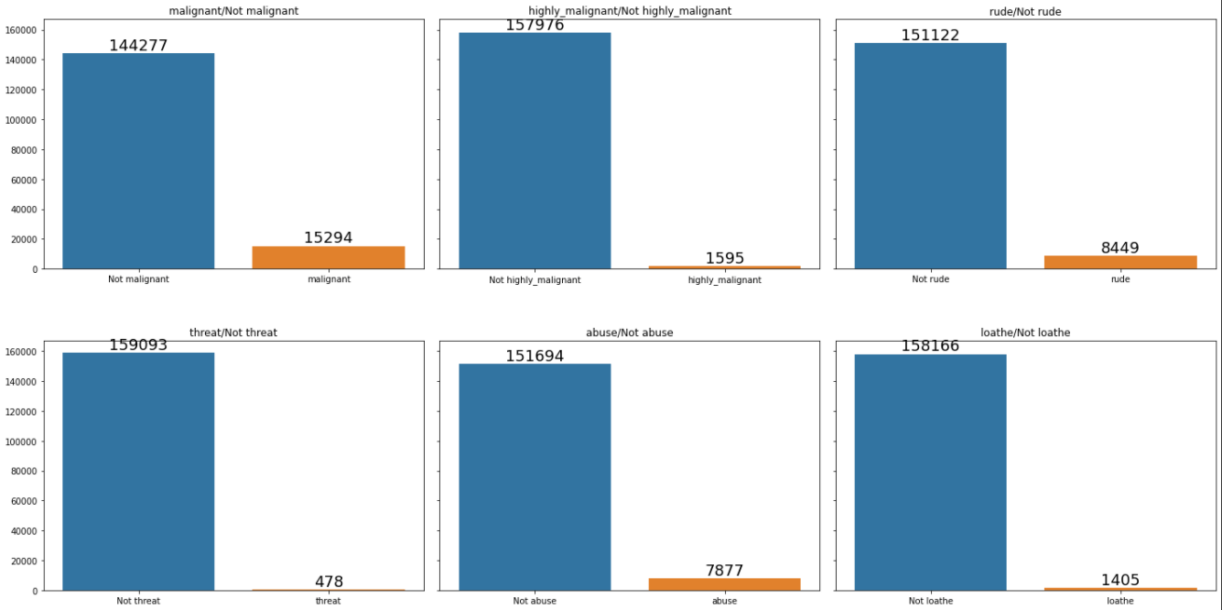
Frequency of Toxic labels vs Clean comments:

Slide 9
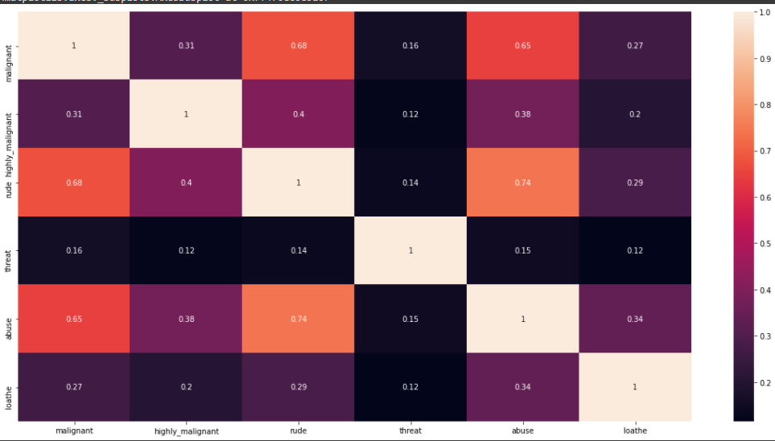
Correlation between toxicity labels

Slide 10
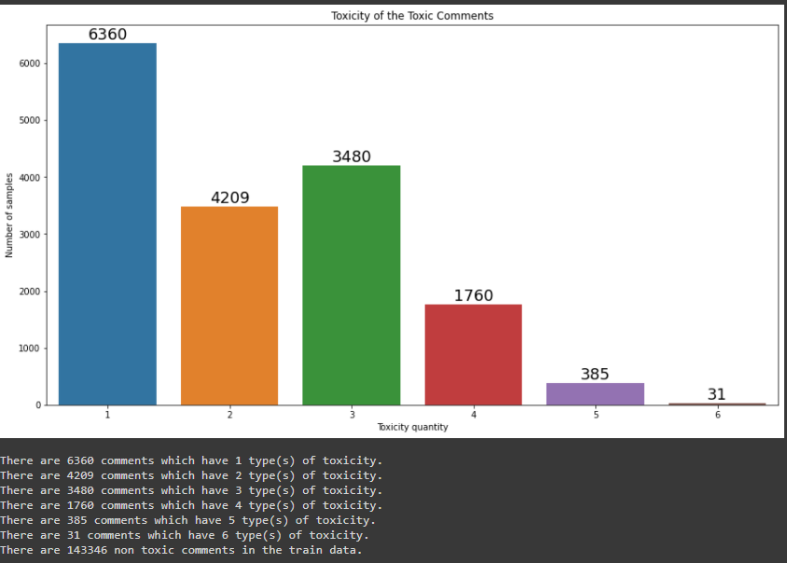
Toxicity of the comments

Slide 11
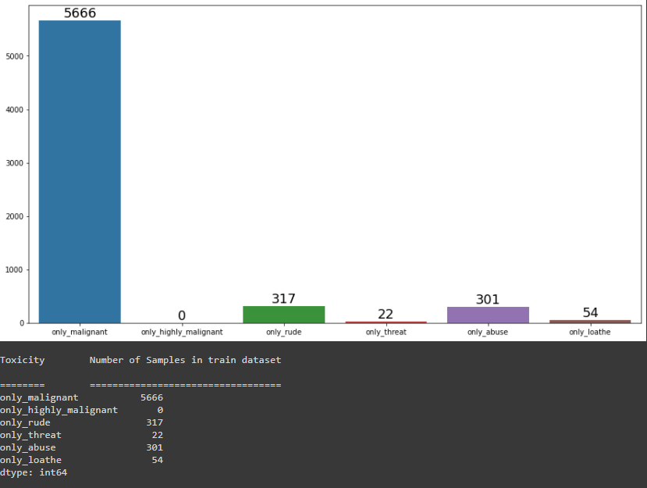
Looking at number of comments that have unique Toxicity

Slide 12
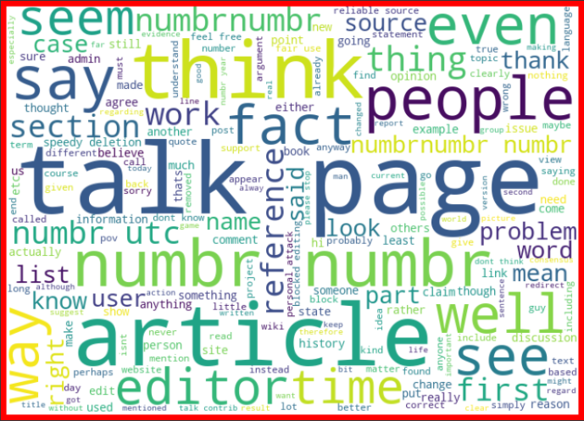
Ratings Word Clouds
Only the Word cloud from clean comments are displayed here for professional reasons.
There are clear distinction between the words used in the clean comments vs toxic comments.
There are some distinctions between the comments with different types of toxicity.
Some words are common between the different types of toxicity labels. Hence monogram, bigram and trigram are used in TFIDF.

Slide 13
Steps taken to complete the Project
Performed data cleaning based on NLP approaches.
Trained and validated different Machine Learning multi-label classification techniques like OneVsRest, Classification Chain, Binary Relevance and Label Powerset.
The Machine Learning Algorithms like Logistic Regression, SGDClassifier, GaussianNB and MultinomialNB are tried with the above techniques.
Chose the final model based on Micro F1 score and Hamming Loss since the dataset is heavily imbalanced.

Slide 14
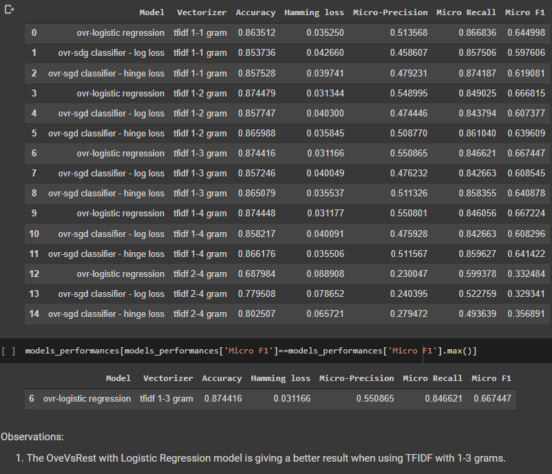
Model score comparison
OneVsRest Technique

Slide 15
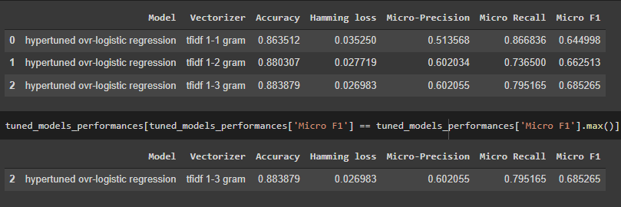
Model score comparison
OneVsRest Technique with hyperparameter tuning the best model

Slide 16
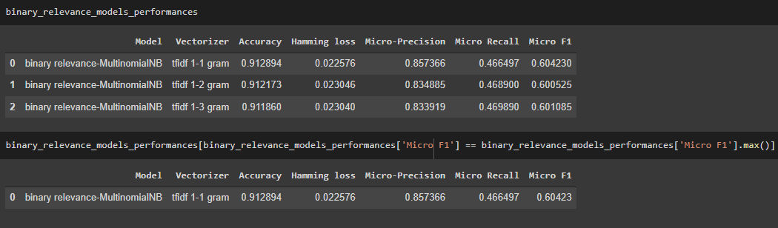
Model score comparison
Binary Relevance Technique with hyperparameter tuning the best model

Slide 17
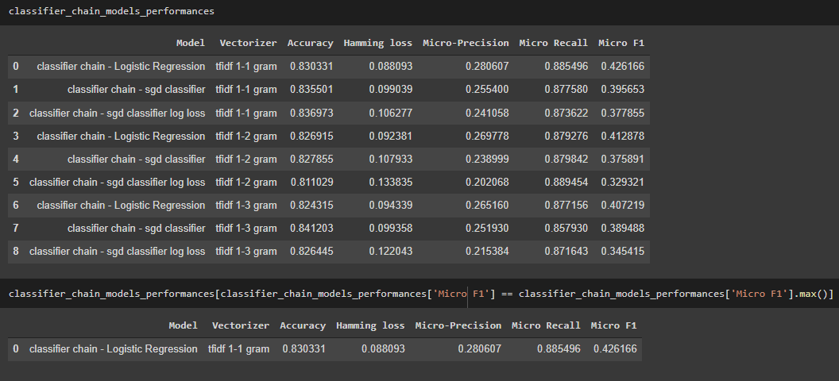
Model score comparison
Classification Chain Technique

Slide 18
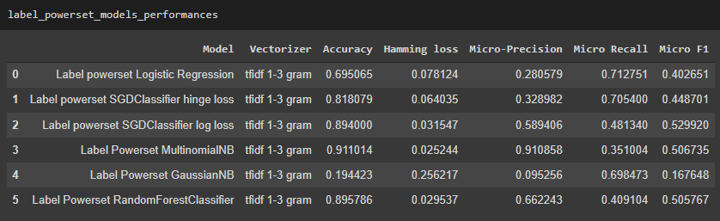
Model score comparison
Label Powerset Technique

Slide 19
Finalized Model
The final model used is Logistic Regression model with OneVsRest technique.
The vectorization is done using 1-3 grams TFIDF Vectorizer
The tuned hyper parameters used are:
OneVsRestClassifier(estimator=LogisticRegression(C=10, class_weight='balanced',
dual=False, fit_intercept=True,
intercept_scaling=1,
l1_ratio=None, max_iter=100,
multi_class='auto’,
n_jobs=None, penalty='l2’,
random_state=None,
solver='lbfgs', tol=0.0001,
verbose=0, warm_start=False),
n_jobs=-1)

Slide 20
Finalized Model scores
Micro F1 Scores with cross_val_score of training dataset:
OneVsRest ROC AUC score:
OneVsRest Weighted ROC AUC score

Slide 21
Conclusion
The OneVsRest technique with Logistic Regression model is giving a better result than the other algorithms tried.
With more computational power Google’s pretrained Word2Vec model can be used to vectorize the comments with better symantic and contextual relationships which could possibly improve the model performance.
With better computation power, ensemble techniques can be used which may improve the predictions.

